Slide 1


CipherSphere: Enveloping Data in Secure Spheres
CipherSphere is a revolutionary data security solution designed to envelop sensitive information in impenetrable spheres, ensuring maximum protection against cyber threats and unauthorized access.

Slide 2
KOYA FATEENA S
Final Project

Slide 3
AGENDA
Problem Statement
Project Overview
Who are the end users
Your solution and its value proposition
The wow in your solution
Modeling
Results

Slide 4

Problem Statement
Data Vulnerability
Cybersecurity Challenges
Many organizations face the risk of data breaches, leading to compromised sensitive information.
Addressing evolving cyber threats has become increasingly complex and demanding.
Unauthorized Access
Unauthorized personnel gaining access to confidential data poses a significant threat.

Slide 5

Project Overview
1
Conceptualization
The idea of CipherSphere taking shape, laying the foundation for a breakthrough security paradigm.
2
Development
Bringing the concept to life through meticulous engineering and cutting-edge encryption technologies.
3
Testing & Refinement
Rigorous testing and refinement to ensure the highest level of data protection and reliability.

Slide 6

Who are the end users
1
Enterprises
2
Government Agencies
Large organizations seeking robust data protection for their sensitive information.
Agencies dealing with classified information and national security interests.
3
Financial Institutions
Banking and financial entities safeguarding customer data and financial records.

Slide 7



YOUR SOLUTION AND ITS VALUE PROPOSITION
Enhanced Security
Streamlined Access
Compliance Assurance
Unparalleled protection of sensitive data, preventing breaches and unauthorized access.
Efficient and secure access controls ensure authorized users can retrieve information without hindrance.
Enables compliance with data protection regulations, reducing legal and financial risks associated with non-compliance.

Slide 8



THE WOW IN YOUR SOLUTION
Ironclad Protection
Lock-Tight Encryption
Key-based Access
Offers a shield of defense, ensuring data remains impervious to threats.
Utilizes state-of-the-art encryption methods to fortify data against any form of infiltration.
Employs secure and reliable key-based access, maintaining control over data retrieval.

Slide 9
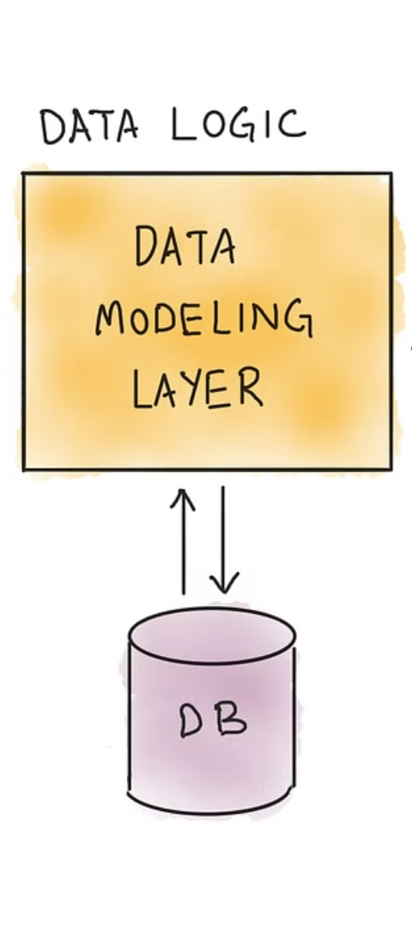



MODELING
Blueprint Creation
Developing a comprehensive blueprint for the secure encapsulation of sensitive data.
Prototyping
Building initial models to assess the framework's functionality and practicality.
Refinement Iterations
Continual refinement based on feedback and rigorous testing to enhance the data encapsulation process.

Slide 10
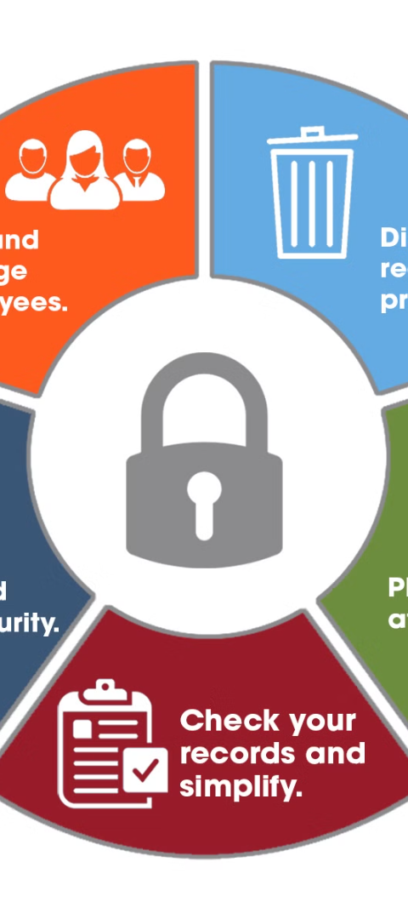
RESULTS
Uncompromising Security
Operational Efficiency
Delivers a level of security that exceeds expectations, safeguarding critical data assets.
Enables seamless data access, promoting efficiency and productivity within organizations.
Positive User Experience
Contributes to a positive user experience, instilling confidence in the security of data.

